Slide 1
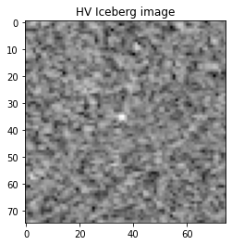
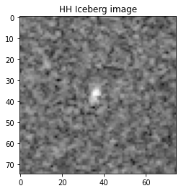
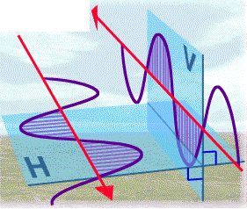
Classification of Ships and Icebergs using SAR satellite Images
Anshul Shrivastava(183310001)
Ali Nasir Bandukwala(193310004)
Guided by: Dr. Gulab Singh

Slide 2
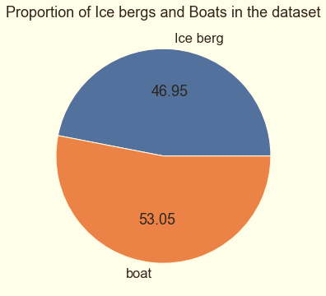
DATASET
We had 1604 images (75, 75, 2) of Iceberg and Ships
Each image had 2 channel bands HH and HV
We used the average of 2 bands as the third band to represent the image into 3 channels

Slide 3
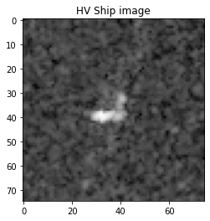
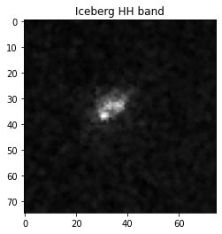
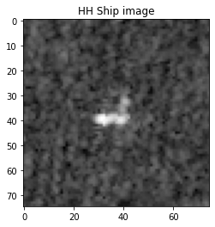
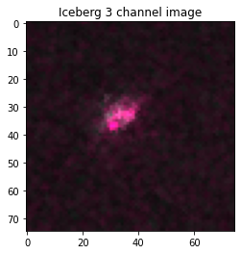
Visualisation of Images in the Dataset

Slide 4
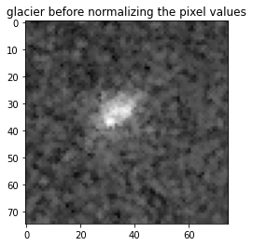
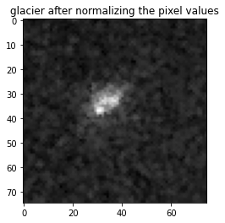
Normalising or Scaling the Pixel values
It is important to normalize the data before feeding to any network.
We have tried to rescale all the decibel values to the range of 0 to 1
Pixel values = exponent(decibel/20)

Slide 5
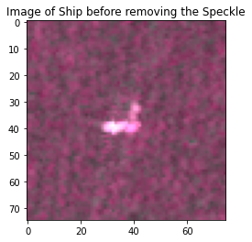
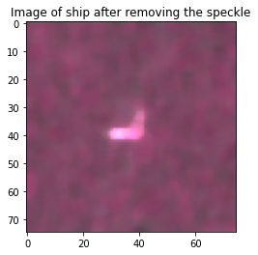
Removing the Speckling Effect
As we Know the SAR images are not smooth as the Optical images.
We have used median filtering to remove the speckling effect.
After Median Filtering

Slide 6
Developing the CNN model
We have used Keras with TensorFlow at the backend.
Compiled the model with Adam Optimizer
Since it is a binary classification therefore it’s obvious to use binary cross-entropy as the loss function
Used Randomized Search method of Keas-tuner to optimize the model

Slide 7
Fitting the CNN model
Dataset was split into 1000 training images and 607 test images to evaluate the model.
Trained the model on 30 epochs with batch size of 300.
Model have 4 convolution layers and 3 dense layers
Activation function in the inner layers is ‘Relu’ and in the outer layer activation function is ‘Sigmoid’.

Slide 8
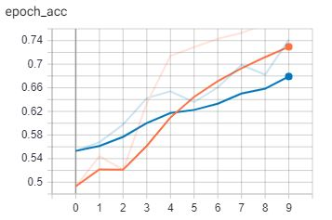
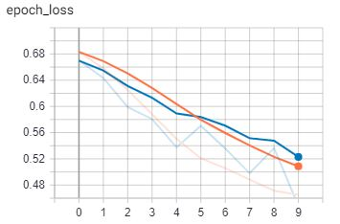
Evaluating the Model after 10 epochs
Train
Train
Test
Test
Accuracy Vs Epoch
Loss Vs Epoch
*After 10 epochs of training

Slide 9

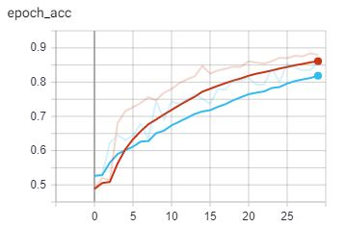
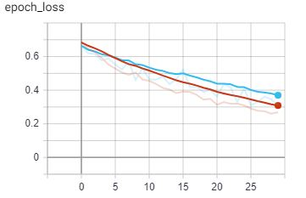
Evaluating the Model after 30 epochs
Accuracy Vs Epoch
Loss Vs Epoch
*After 30 epochs of training

Slide 10
Model Summary
Validation Loss - 0.35
Validation Accuracy - 81 percent
 | precision | recall | f1-score | support
0.0 | 0.73 | 0.96 | 0.83 | 276
1.0 | 0.95 | 0.70 | 0.80 | 328

Slide 11
REFERENCES
(2018). Retrieved from Kaggle.com: https://www.kaggle.com/c/statoil-iceberg-classifier-challenge/data
(2020, may 20). Retrieved from Tensorflow.org: https://www.tensorflow.org/tensorboard/get_started
Getting started . (n.d.). Retrieved from Keras.io: https://keras.io/getting_started/

